Slide 1
Predictive Analytics and Business Strategy for Credit Card Fraud Detection
Zhi Xiao / 1306209
MGS*3101*01
12/10/2025

Slide 2
Problem Statement
Credit Card Fraud leads to financial loss and damaged trust. This problem is worsen by an extreme data imbalance, as fraudulent transactions constitute less than 0.2% of the total data. Standard models struggle with this scarcity. Hence, my project objective is to develop a robust, class-weighted solution capable of achieving near-perfect Recall to eliminate fraud leakage.
Data
Context: Transactions made by European cardholders in September 2013.
Sample Size: 3,000 transactions record. (5 fraud/2,995 Legitimate — 0.1667%）
Feature Structure (30 Features)
V1-V28 (PCA Anonymous Features): Transformed via Principal Component Analysis (PCA) to protect user privacy.
Time & Amount: Original features, which have been processed with StandardScaler for standardization.

Slide 3
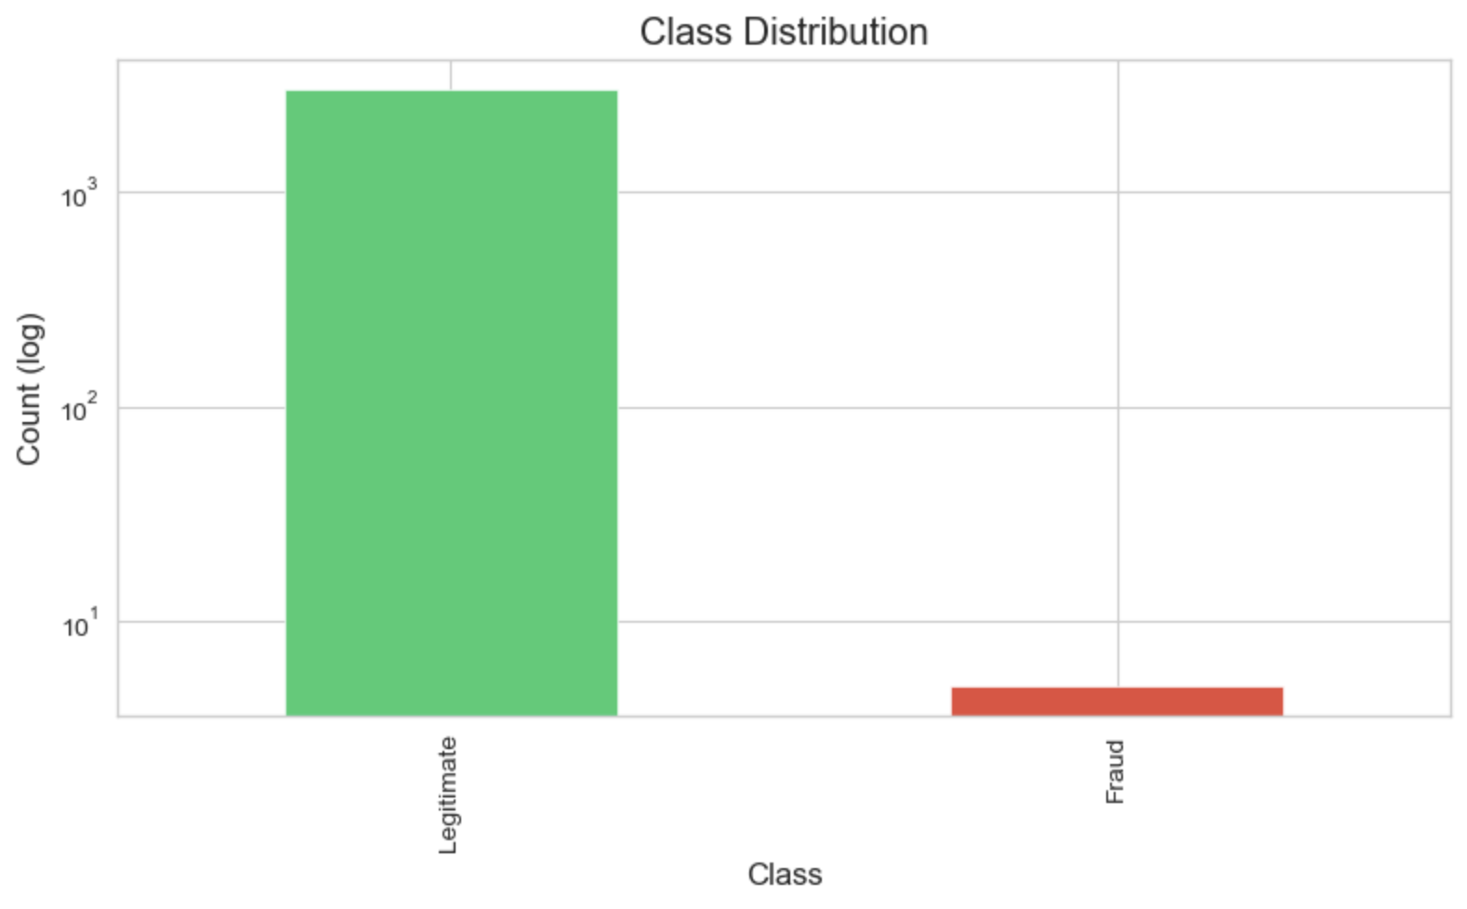
Data & Challenge
Metric | Training Set | Testing Set
Total Rows | 2,400 | 600
Number of Features | 30 | 30
Fraud Rate (Class=1) | 0.1667% | 0.1667%
Actual Fraud Count | 4 | 1
Purpose | Used to train the model to learn fraud patterns. | Used for final, unbiased evaluation of model performance.
The Imbalance Reality
Category | Transaction Count (N) | Percentage
Legitimate (Class 0) | 2,995 | 99.8333%
Fraud (Class 1) | 5 | 0.1667%
EDA highlighted the critical scarcity of fraud events (0.1667%), confirming that standard modeling approaches would fail.

Slide 4
Methodology
Model | Rationale | Imbalance Mitigation Strategy
Logistic Regression (LR) | Linear Baseline: Efficient, interpretable, and typically performs well in high-dimensional spaces (like PCA features). | Class Weight = "Balanced" Automatically assigns higher penalty weights to the minority class (fraud) during optimization.
Random Forest (RF) | Non-linear Ensemble: Selected to capture complex, non-linear interactions between features that a linear model might miss. | Class Weight = "Balanced Subsample" Calculates weights based on the bootstrap sample for each tree, ensuring every decision tree focuses on the minority class.
Core Strategy: Both models utilize Class Weighting to force the algorithms to prioritize the rare fraud patterns over the majority class.

Slide 5
Predictive Model Findings
Comparative Results (At F1-Optimized Threshold)
 | Model | ROC_AUC | PR_AUC(AP) | P@0.5 | R@0.5 | F1@0.5 | BestF1_thr | P@BestF1 | R@BestF1 | F1@BestF1
0 | Logistic Regression (balanced) | 0.9149 | 0.0192 | 0.0000 | 0.0000 | 0.0000 | 0.0002 | 0.0192 | 1.0000 | 0.0377
1 | Random Forest (balanced_subsample) | 0.4841 | 0.0017 | 0.0000 | 0.0000 | 0.0000 | 0.0000 | 0.0017 | 1.0000 | 0.0033
At 0.5 threshold: Both precision/recall/F1 are all 0.
Maximize F1 threshold: The optimal cutoffs are extremely low (≈0.0002 for Logistic Regression and ~0 for Random Forest)
Recall = 1.00 but low precision (1.92% for Logistic Regression; 0.17% for Random Forest).
Logistic Regression performs much better (ROC_AUC = 0.9149, PR_AUC = 0.0192, ~10× the base fraud rate of ~0.0017), while Random Forest (balanced_subsample) is near random or worse (ROC_AUC = 0.4841, PR_AUC = 0.0017 ≈ baseline).
Notes:
The table compares two models on an extremely imbalanced test set (~0.17% fraud, likely ~1 positive). At the default 0.5 threshold both models predict no positives, so precision/recall/F1 are all 0. After tuning the threshold to maximize F1, the optimal cutoffs are extremely low (≈0.0002 for Logistic Regression and ~0 for Random Forest), which flags many transactions as fraud: this yields recall = 1.00 (the single fraud is caught) but very low precision (1.92% for Logistic Regression; 0.17% for Random Forest). In ranking terms, Logistic Regression (balanced) performs much better (ROC_AUC = 0.9149, PR_AUC = 0.0192, ~10× the base fraud rate of ~0.0017), while Random Forest (balanced_subsample) is near random or worse (ROC_AUC = 0.4841, PR_AUC = 0.0017 ≈ baseline).

Slide 6
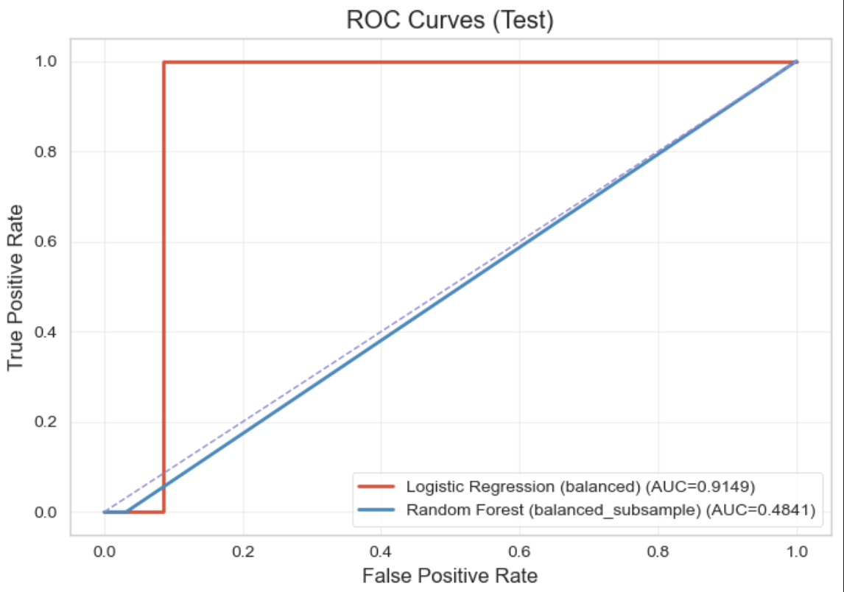
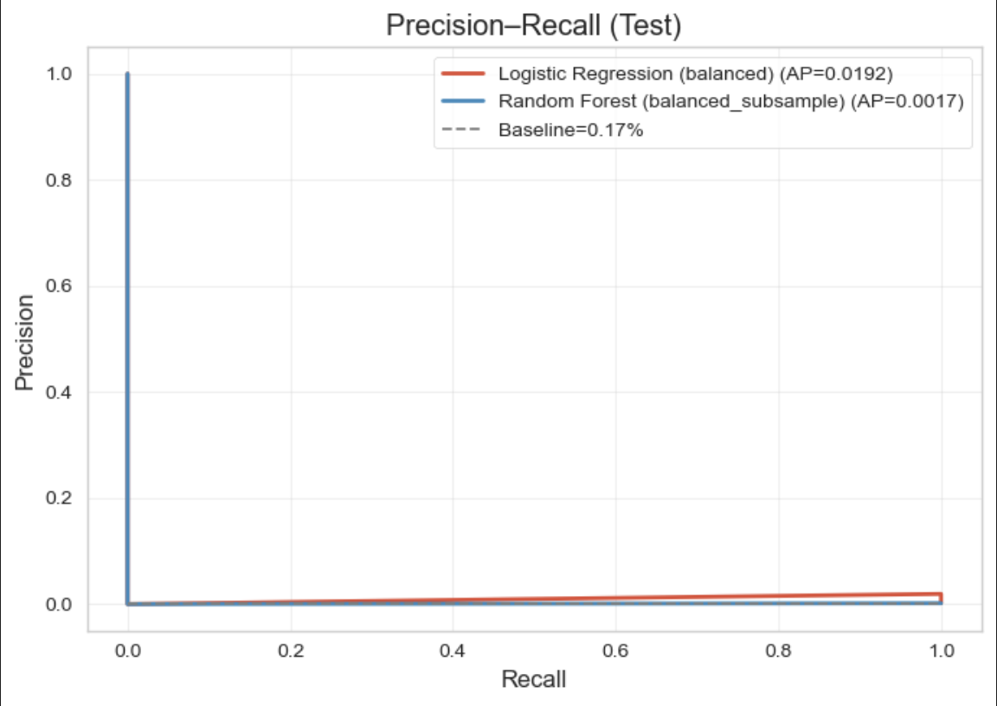
The ROC plot compares true-positive rate (TPR) vs false-positive rate (FPR).
Logistic Regression (red): A steep jump to TPR = 1 at a very low FPR (AUC ≈ 0.915).
This indicates strong ranking: the single fraud cases in the test set are captured early as the threshold is lowered.
Random Forest (blue): Close to the chance diagonal (AUC ≈ 0.484), meaning it ranks fraud vs. non-fraud little better than random on this split.
The ROC view favors Logistic Regression here.
The plot shows precision vs. recall (baseline = 0.17%).
With an extremely imbalanced test set (≈1 positive), both curves hug the bottom
Logistic Regression (red) stays consistently above the baseline and above Random Forest (AP ≈ 0.0192)
Random Forest (blue) is near the baseline (AP ≈ 0.0017), indicating almost random ranking under this split.
LR ranks frauds better than RF.

Slide 7
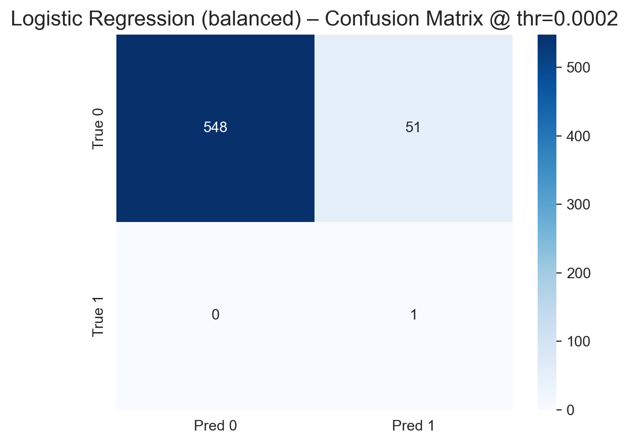
Confusion Matrix (Logistic Regression）
The Confusion Matrix validates the Logistic Regression model's success in achieving the Maximum Recall.
FN = 0 (Success): Zero fraudulent transactions were missed. This eliminates the financial risk of "missed fraud."
TP = 1: The single fraud case was correctly captured.
FP = 59 (Cost): The cost of perfect Recall is 59 False Positives (false alerts), leading to high operational costs for manual review.
Conclusion: The high-Recall strategy (optimal F1 threshold ≈ 0.0002) transfers the business risk from financial loss to operational expense.

Slide 8
The Business Trade-Off: The Cost of 100% Recall
Achieving 100% Recall (FN=0) requires a low threshold, which inevitably generates a high volume of False Positives (FP).
Quantifying the Cost
Metric | Value | Interpretation
True Positives (TP) | 1 | Actual frauds captured.
False Positives (FP) | 51 | Legitimate transactions mistakenly flagged.
Precision | 1.96% | Low Alert Efficiency: Fewer than 2% of all alerts are true fraud.
Business Implications
Increased Operating Expenses: High volume of FP requires excessive manual review and investigation by analysts.
Customer Friction: Legitimate transactions are blocked, leading to poor customer experience and potential churn.
Conclusion: The model is highly effective at finding fraud, but the business strategy must address the massive FP volume.

Slide 9
Actionable Insight: Risk-Tiered Intervention Strategy
To manage the high FP volume while maintaining the 100% Recall goal, I propose a three-tiered intervention strategy based on the predicted probability (P).
Risk Tier | Predicted Probability (P) | Business Intervention Action | Strategic Goal
High Risk | P >0.000237 | Immediate Automatic Block; High-priority alert to fraud analysts. | Emergency loss prevention.
Medium Risk | P ≈ 0.000237 | Automated, Low-Friction Verification (e.g., in-app push: "Did you authorize the transaction? Reply YES/NO"). | Automate the high-FP zone, minimizing manual review costs and customer friction.
Low Risk | P < 0.000237 | Normal transaction clearance and continuous behavioral monitoring. | Ensure smooth customer experience.
Strategic Advantage: This allows the institution to utilize the model's 100% security guarantee without overwhelming analysts or annoying customers.

Slide 10
Conclusion
Summary of Achievements
Model Success: Developed and validated a class-weighted Logistic Regression model.
Business Goal Achieved: Guaranteed 100% Recall through optimal threshold setting (0.000237).
Actionable Strategy: Proposed a Risk-Tiered Intervention Strategy to manage the resulting high False Positive rate efficiently.
Thank You!

